Slide 1

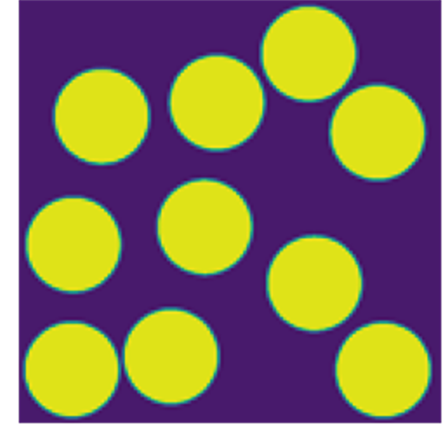
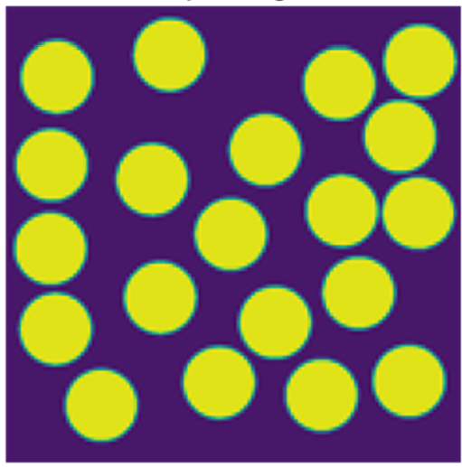
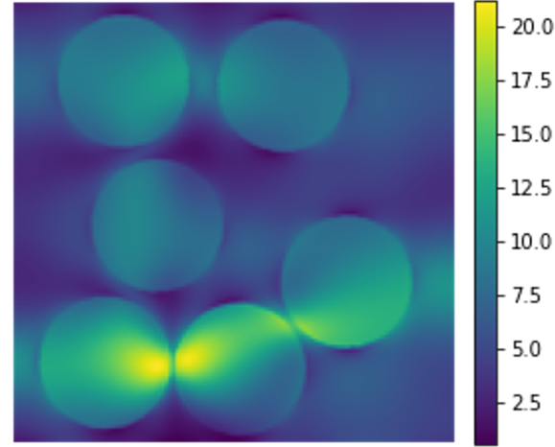
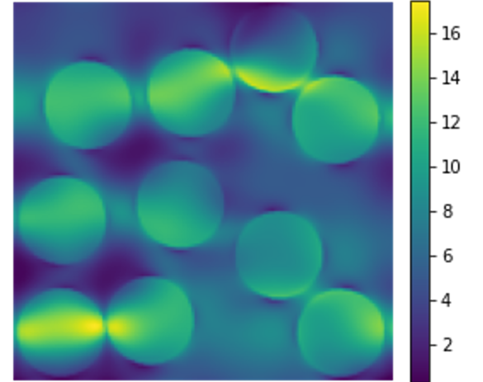
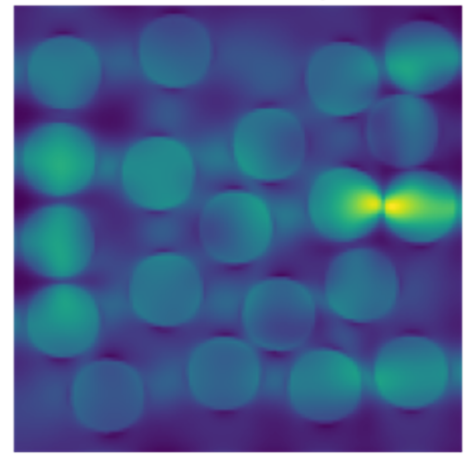


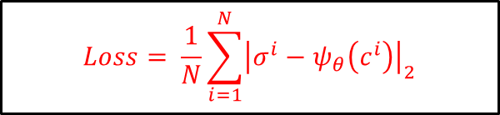

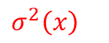
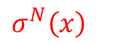

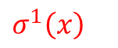
Example: Parameterized linear elasticity
$$c^{1}(x)$$
$$c^{2}(x)$$
$$c^{N}(x)$$
Input c(x)
…
Training
$σ^{1}\left(x\right)$
$σ^{2}\left(x\right)$
$σ^{N}\left(x\right)$
Output $σ\left(x\right)$
…
$$Loss= \frac{1}{N}\sum_{i=1}^{N}{{\left|σ^{i}−ψ_{θ}\left(c^{i}\right)\right|}_{2}}$$

Slide 2
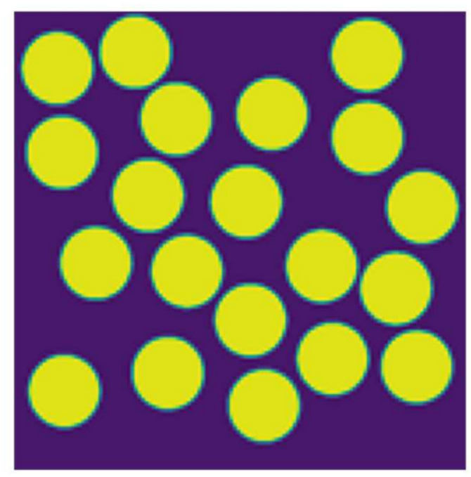
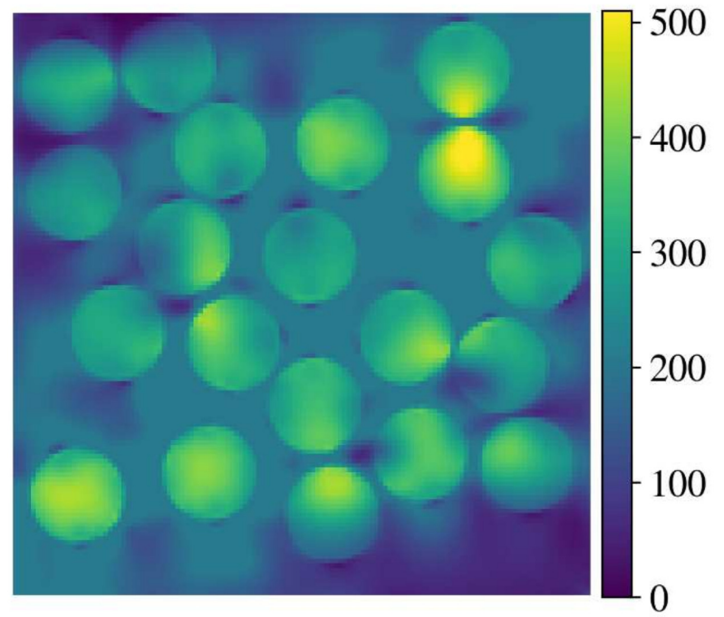

Example: Parameterized linear elasticity
Input of interest c(x)
Output
$$ψ_{θ}\left(c\right)$$
Test
Test data not in the training data set

Slide 3
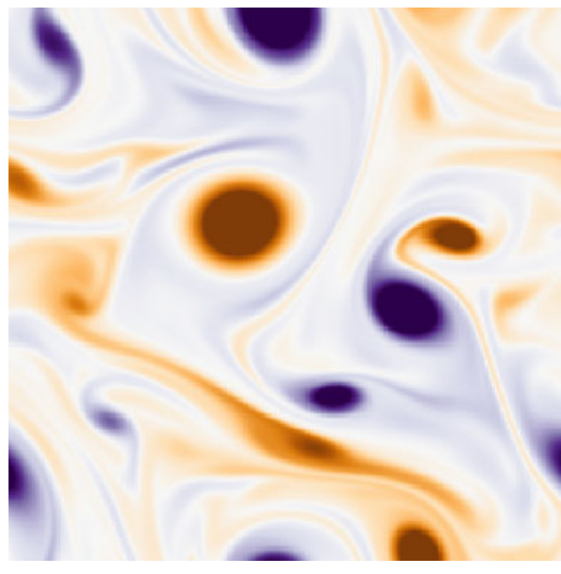
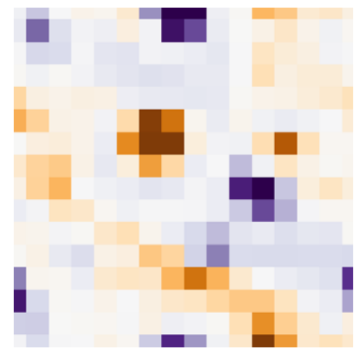
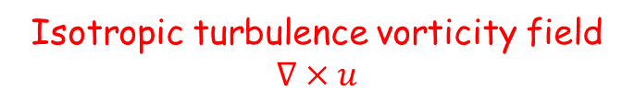
What is special about it?
Physics are infinite dimensional
High resolution
Low resolution
This looks like an ideal problem for classical neural networks (e.g., CNN) at the first glance.
However, Operators maps functions to functions.
Functions are infinite dimensional objects.
Image on the other hand is a finite dimensional object that finite resolution (e.g., 16x616, 256x256). It can be thought as a discretization of a function.
Isotropic turbulence vorticity field $∇×u$
Fukami, Kai, Koji Fukagata, and Kunihiko Taira. "Super-resolution analysis via machine learning: a survey for fluid flows." Theoretical and Computational Fluid Dynamics (2023): 1-24.

Slide 4
What is special about it?
Example – Darcy flow problem
In practice
If one train classical neural networks (CNN, Res-Net, U-net etc.) to learn operators at from data obtained at a single resolution.
If one then test the trained architecture with obtained from different resolutions.
The test error will increase dramatically – classical architecture are optimized at a single resolution.
CNN, Testing
CNN, training
Kovachki, Nikola, et al. "Neural operator: Learning maps between function spaces with applications to PDEs." Journal of Machine Learning Research 24.89 (2023): 1-97.

Slide 5
Can we build neural networks in function space?
Example – Darcy flow problem
Nueral Operator
We wish to design architectures that maps function to function.
This is a generalization of Neural Network that maps finite dimensional vectors to vectors.
In practice, we wish to design architecture that can flat the curve.
Train in one resolution and can generalize to other resolutions with little or no increase in test error.
This is also known as one-shot super resolution.
Neural Networks
Neural Operator
Kovachki, Nikola, et al. "Neural operator: Learning maps between function spaces with applications to PDEs." Journal of Machine Learning Research 24.89 (2023): 1-97.

Slide 6
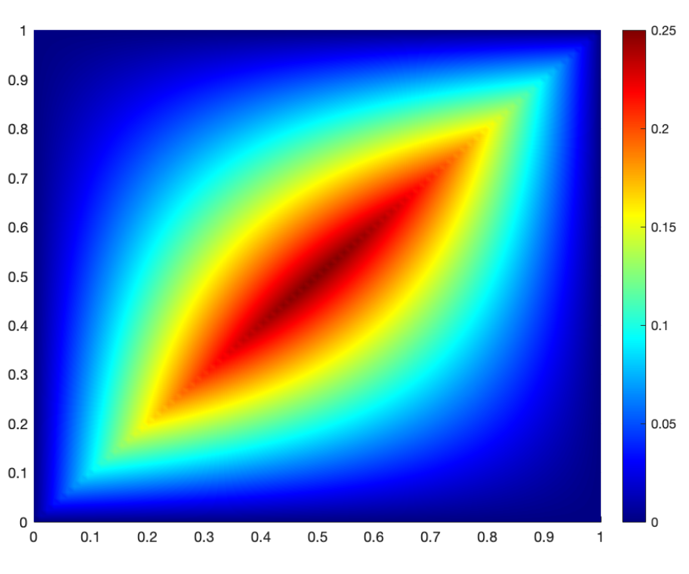

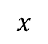
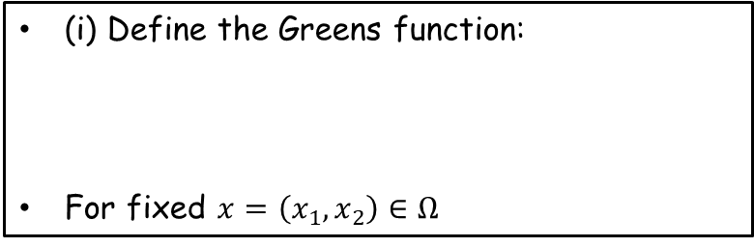
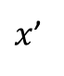
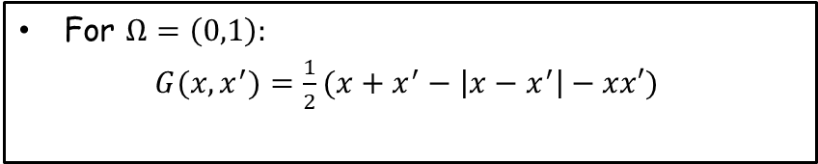
Solution operator for Poisson’s equation
Poisson’s equation
Example: Poisson’s equation in 1D
(i) Governing equation:
(ii) Boundary condition (closure):
For $Ω=\left(0,1\right):$
$G(x,x^{′})=\frac{1}{2}(x+x^{′}−\left|x−x^{′}\right|−xx′)$
$∇∙∇u=f(x)$ | $u∈Ω$
$$u=0$$ | $u∈∂Ω$
G is also called a kernel function
Green’s function
(i) Define the Greens function:
For fixed $x=\left(x_{1},x_{2}\right)∈Ω$
$∇⋅∇G(x,x^{′})=δ(x−x^{′})$ | $$x^{′}∈Ω$$
$x$’
$G(x,x^{′})=0$ | $$x^{′}∈∂Ω$$
Solution operator
$$\left(ψ^{†}f\right)\left(x\right)= \int_{Ω}{G\left(x,x^{′}\right)f\left(x^{′}\right)dx}$$
$$x$$

Slide 7
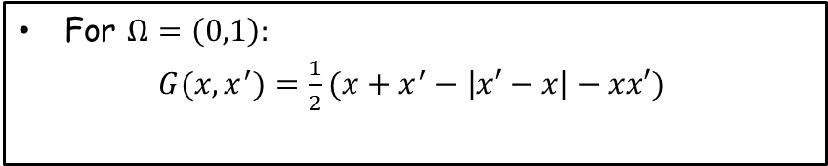
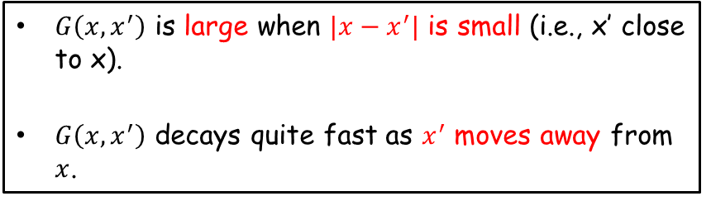
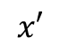
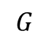
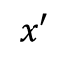
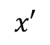
Solution operator for Poisson’s equation
Example: Poisson’s equation in 1D
Observation
For $Ω=\left(0,1\right):$
$G(x,x^{′})=\frac{1}{2}(x+x^{′}−\left|x′−x\right|−xx′)$
$G\left(x,x^{′}\right)$ is large when $|x−x^{′}|$ is small (i.e., x’ close to x).
$G\left(x,x^{′}\right)$ decays quite fast as $x^{′}$ moves away from $x$.
Kernal G(x=0.1, x’)
Kernal G(x=0.5, x’)
Kernal G(x=0.8, x’)
$$G$$
$$x′$$
$$x′$$
$$x′$$

Slide 8
Solution operator for Poisson’s equation
Example: Poisson’s equation in 1D
Observation
For $Ω=\left(0,1\right):$
$G(x,x^{′})=\frac{1}{2}(x+x^{′}−\left|x′−x\right|−xx′)$
$G\left(x,x^{′}\right)$ is large when $|x−x^{′}|$ is small (i.e., x’ close to x).
$G\left(x,x^{′}\right)$ decays quite fast as $x^{′}$ moves away from $x$.
What does this remind us?
Kernal G(x=0.1, x’)
Kernal G(x=0.5, x’)
Kernal G(x=0.8, x’)
$$G$$
$$x′$$
$$x′$$
$$x′$$

Slide 9
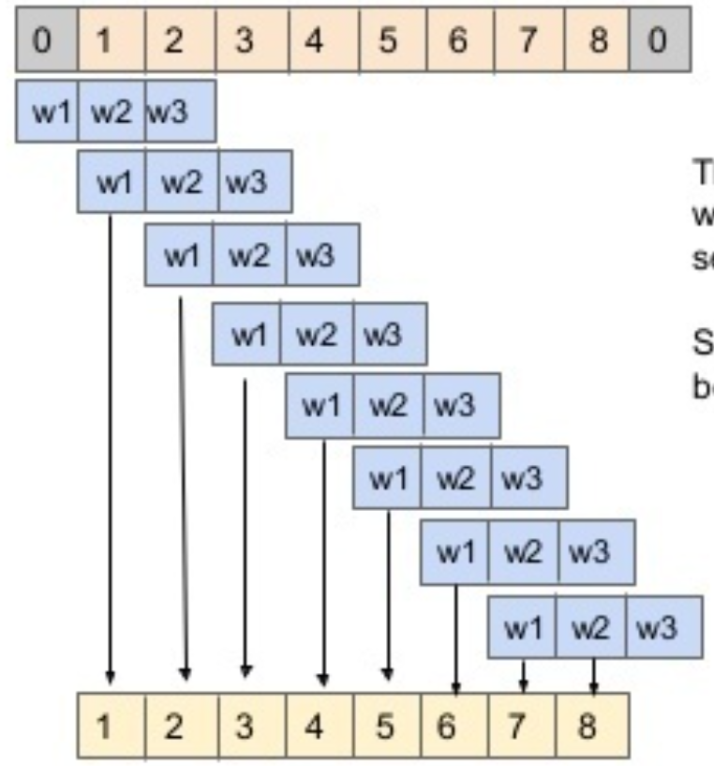
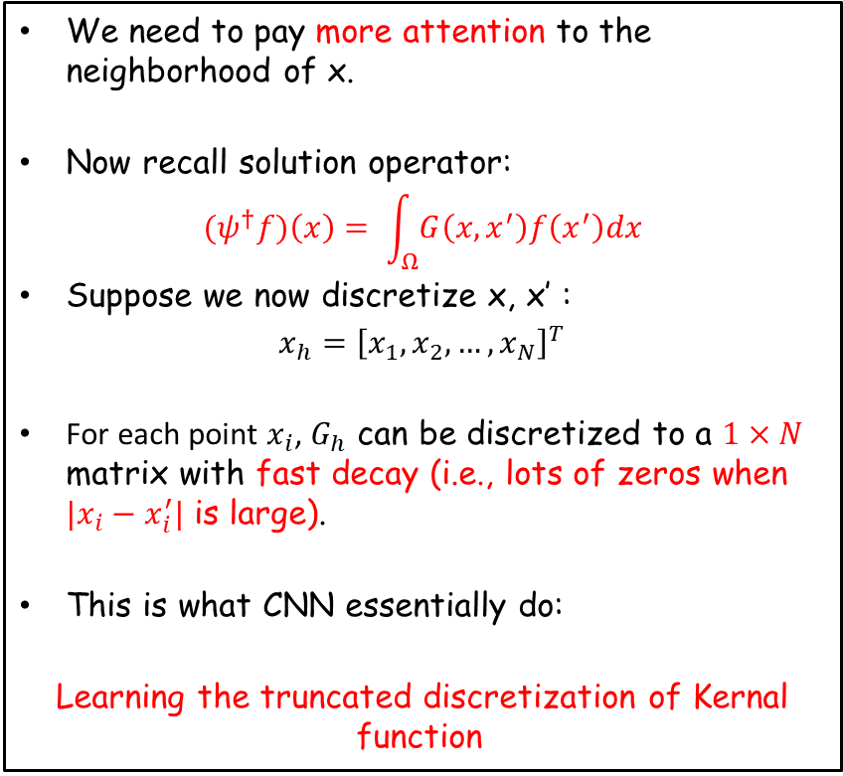
Rationalize CNN – truncated discretization of kernel function
Example: Poisson’s equation in 1D
Observation
For $Ω=\left(0,1\right):$
$G(x,x^{′})=\frac{1}{2}(x+x^{′}−\left|x′−x\right|−xx′)$
We need to pay more attention to the neighborhood of x.
Now recall solution operator:
$${(ψ}^{†}f)\left(x\right)= \int_{Ω}{G\left(x,x^{′}\right)f\left(x^{′}\right)dx}$$
Suppose we now discretize x, x’ :
${x_{h}=\left[x_{1},x_{2},…, x_{N}\right]}^{T}$
For each point $x_{i}$, $G_{h}$ can be discretized to a $1×N$ matrix with fast decay (i.e., lots of zeros when ${|x}_{i}−x_{i}^{′}|$ is large).
This is what CNN essentially do:
Learning the truncated discretization of Kernal function
1D Convolution layer
But not in an elegant manner!

Slide 10

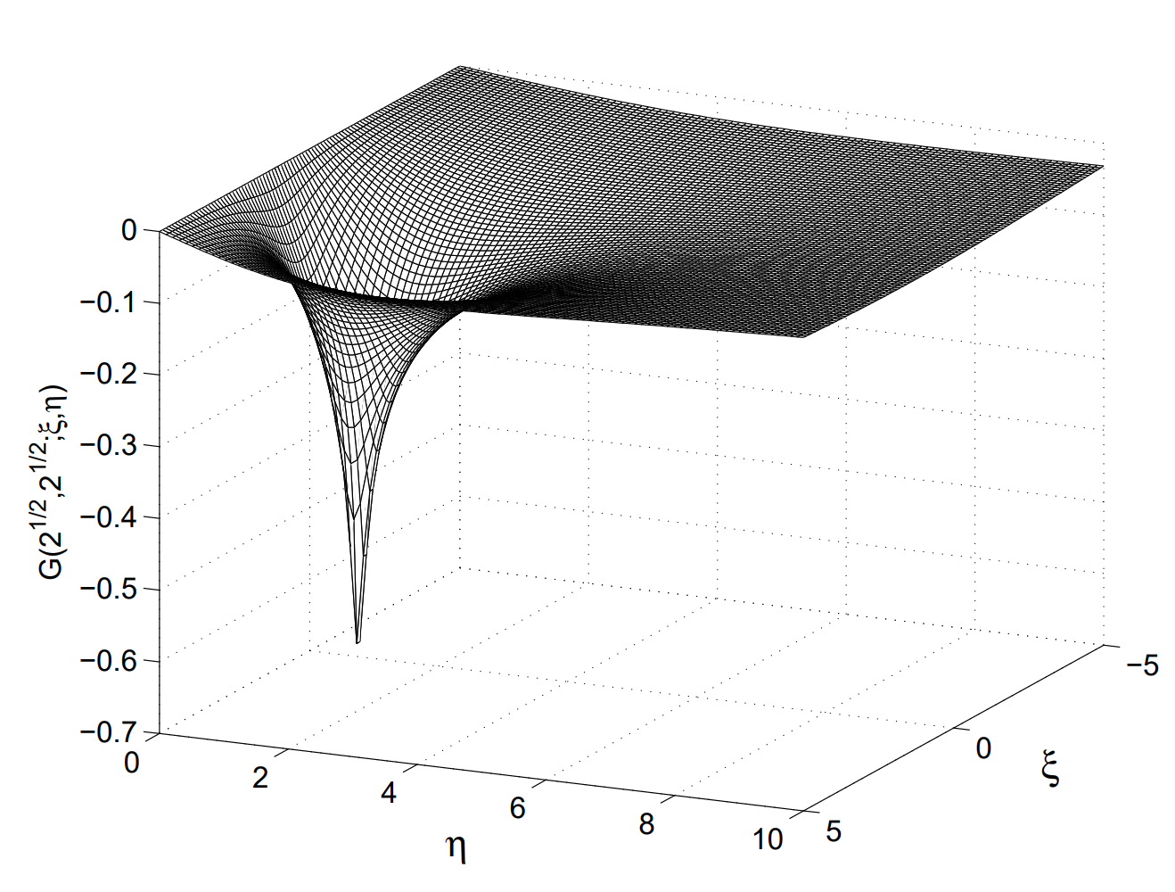
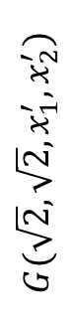
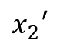
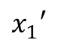
Rationalize CNN – truncated discretization of kernel function
2D Green’s function for Laplacian operator
2D CNN filter
$$G(\sqrt{2}, \sqrt{2}, x_{1}^{′}, x_{2}^{′})$$
$$x_{2}′$$
$$x_{1}′$$
Why do we need channels in CNN?

Slide 11
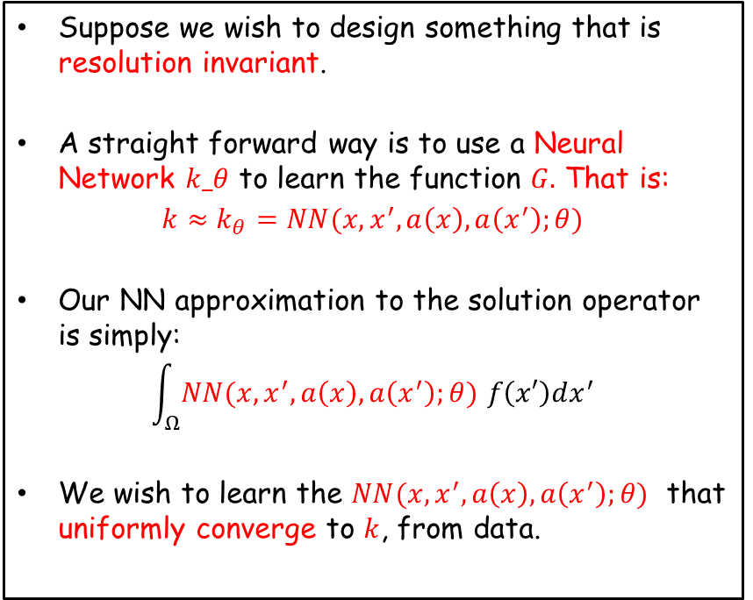
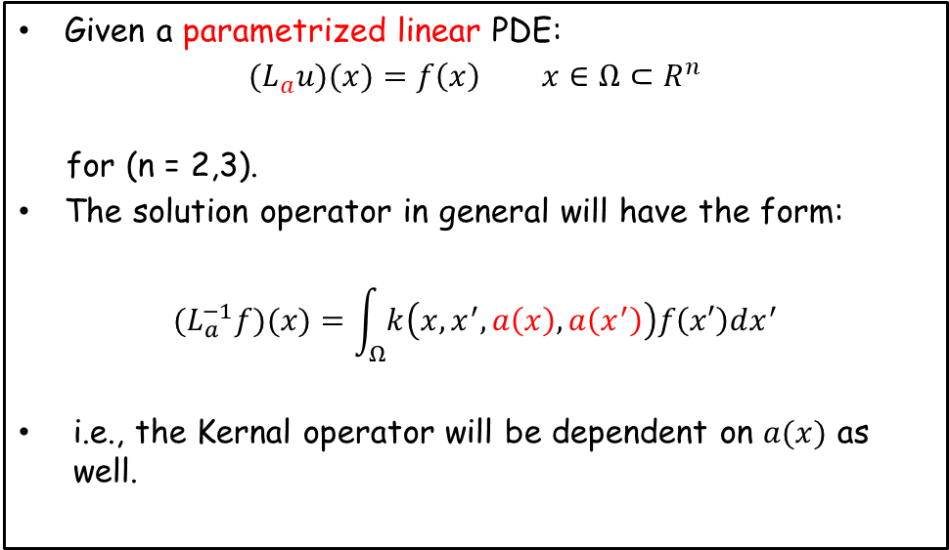
Solution operator for linear PDEs
Generalization from the 1D case
This motivates Neural Operators
Given a parametrized linear PDE:
${(L}_{a}u)(x)=f\left(x\right)$ $x∈Ω⊂R^{n}$
for (n = 2,3).
The solution operator in general will have the form:
$${(L}_{a}^{−1}f)(x)=\int_{Ω}{k\left(x,x^{′},a\left(x\right),a\left(x^{′}\right)\right)f\left(x′\right)dx^{′}}$$
i.e., the Kernal operator will be dependent on $a(x)$ as well.
Suppose we wish to design something that is resolution invariant.
A straight forward way is to use a Neural Network $k_θ$ to learn the function $G.$ That is:
$k≈k_{θ}=NN(x,x^{′},a\left(x\right),a\left(x^{′}\right);θ)$
Our NN approximation to the solution operator is simply:
$$\int_{Ω}{NN(x,x^{′},a\left(x\right),a\left(x^{′}\right);θ) f\left(x′\right)dx^{′}}$$
We wish to learn the $NN(x,x^{′},a\left(x\right),a\left(x^{′}\right);θ)$ that uniformly converge to $k$, from data.
Ok – but how about nonlinear operators?

Slide 12
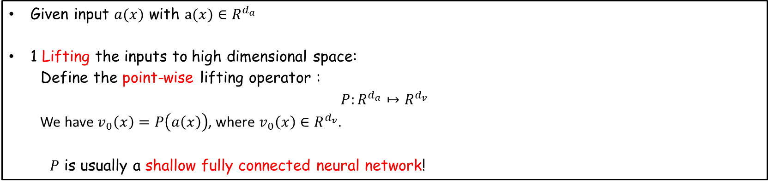
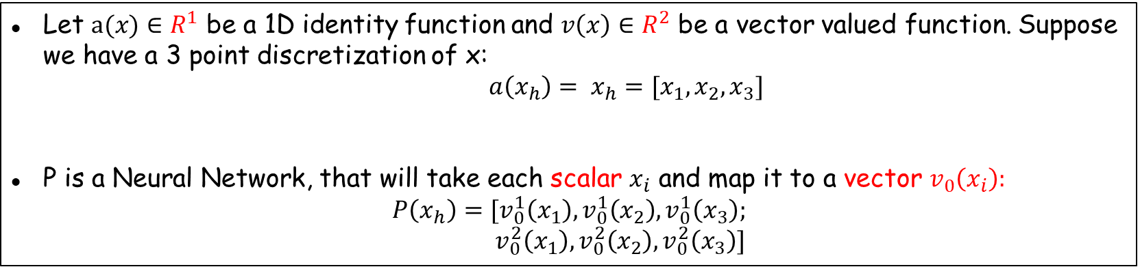
Neural Operator architecture
Given input $a(x)$ with $a(x)∈R^{d_{a}}$
1 Lifting the inputs to high dimensional space:
Define the point-wise lifting operator :
$$P:R^{d_{a}}↦R^{d_{v}}$$
We have $v_{0}\left(x\right)=P\left(a\left(x\right)\right)$, where $v_{0}\left(x\right)∈R^{d_{v}}$.
$P$ is usually a shallow fully connected neural network!
Example
Let $a(x)∈R^{1}$ be a 1D identity function and $v\left(x\right)∈R^{2}$ be a vector valued function. Suppose we have a 3 point discretization of x:
${a\left(x_{h}\right)= x}_{h}=[x_{1},x_{2},x_{3}]$
P is a Neural Network, that will take each scalar $x_{i}$ and map it to a vector $v_{0}\left(x_{i}\right):$
$$P\left(x_{h}\right)=[v_{0}^{1}\left(x_{1}\right), v_{0}^{1}\left(x_{2}\right), v_{0}^{1}\left(x_{3}\right);$$
$$v_{0}^{2}\left(x_{1}\right), v_{0}^{2}\left(x_{2}\right), v_{0}^{2}\left(x_{3}\right)]$$

Slide 13
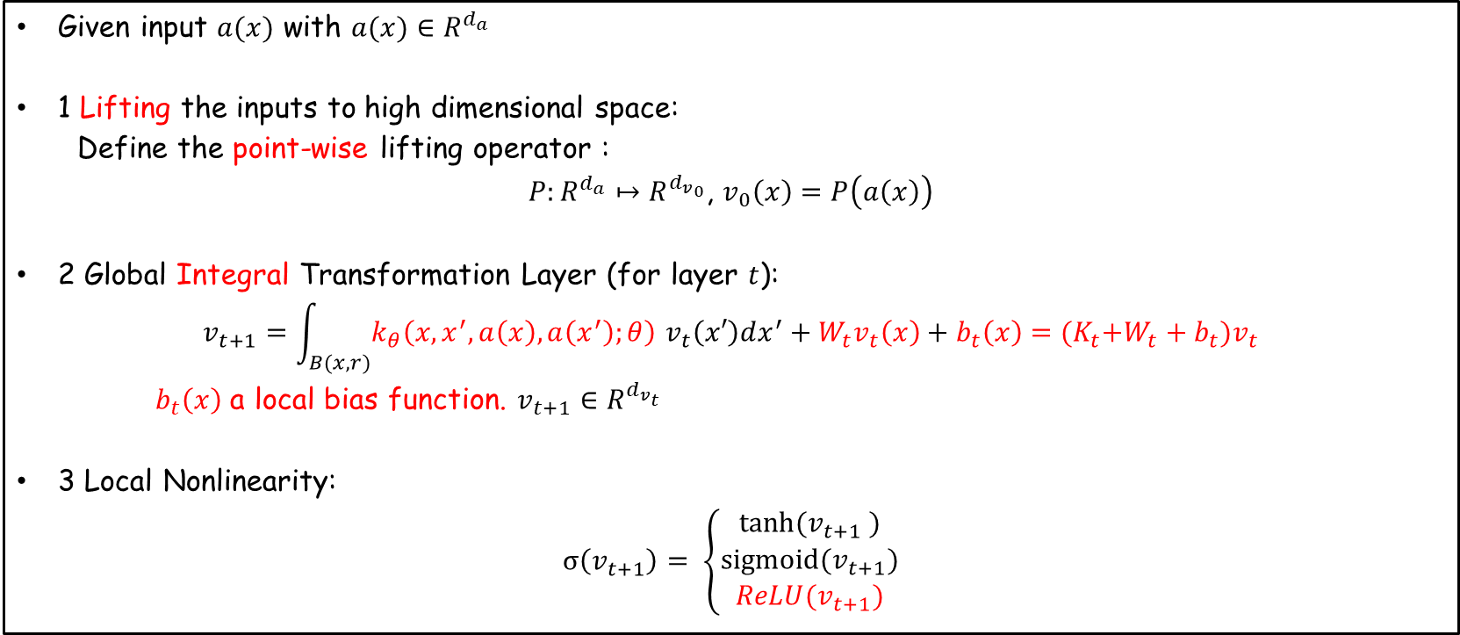
Neural Operator architecture
Architecture for a T layer Nueral Operator
Given input $a(x)$ with $a(x)∈R^{d_{a}}$
1 Lifting the inputs to high dimensional space:
Define the point-wise lifting operator :
$P:R^{d_{a}}↦R^{{d_{v}}_{0}}$, $v_{0}\left(x\right)=P\left(a\left(x\right)\right)$
2 Global Integral Transformation Layer (for layer $t$):
$$v_{t+1}=\int_{B(x,r)}{k_{θ}\left(x,x^{′},a\left(x\right),a\left(x^{′}\right);θ\right) v_{t}\left(x′\right)dx^{′}}+W_{t}v_{t}\left(x\right)+b_{t}\left(x\right)={(K}_{t}{+W_{t}+b}_{t})v_{t}$$
$b_{t}\left(x\right)$ a local bias function. $v_{t+1}∈R^{d_{v_{t}}}$
3 Local Nonlinearity:
$$σ\left(v_{t+1}\right)= \left\{\begin{aligned}tanh⁡(v_{t+1} ) \\ sigmoid(v_{t+1}) \\ ReLU(v_{t+1})\end{aligned}\right.$$

Slide 14
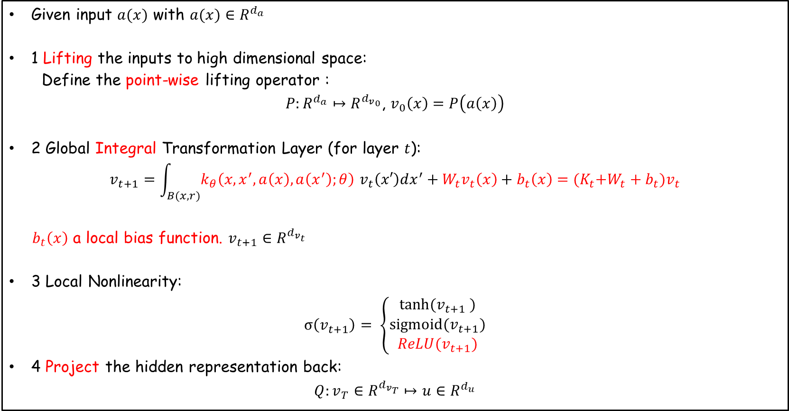
Neural Operator architecture
Architecture for a T layer Nueral Operator
Given input $a(x)$ with $a(x)∈R^{d_{a}}$
1 Lifting the inputs to high dimensional space:
Define the point-wise lifting operator :
$P:R^{d_{a}}↦R^{{d_{v}}_{0}}$, $v_{0}\left(x\right)=P\left(a\left(x\right)\right)$
2 Global Integral Transformation Layer (for layer $t$):
$$v_{t+1}=\int_{B(x,r)}{k_{θ}\left(x,x^{′},a\left(x\right),a\left(x^{′}\right);θ\right) v_{t}\left(x′\right)dx^{′}}+W_{t}v_{t}\left(x\right)+b_{t}\left(x\right)={(K}_{t}{+W_{t}+b}_{t})v_{t}$$
$b_{t}\left(x\right)$ a local bias function. $v_{t+1}∈R^{d_{v_{t}}}$
3 Local Nonlinearity:
$$σ\left(v_{t+1}\right)= \left\{\begin{aligned}tanh⁡(v_{t+1} ) \\ sigmoid(v_{t+1}) \\ ReLU(v_{t+1})\end{aligned}\right.$$
4 Project the hidden representation back:
$$Q:v_{T}∈R^{d_{v_{T}}}↦{u∈R}^{d_{u}}$$

Slide 15
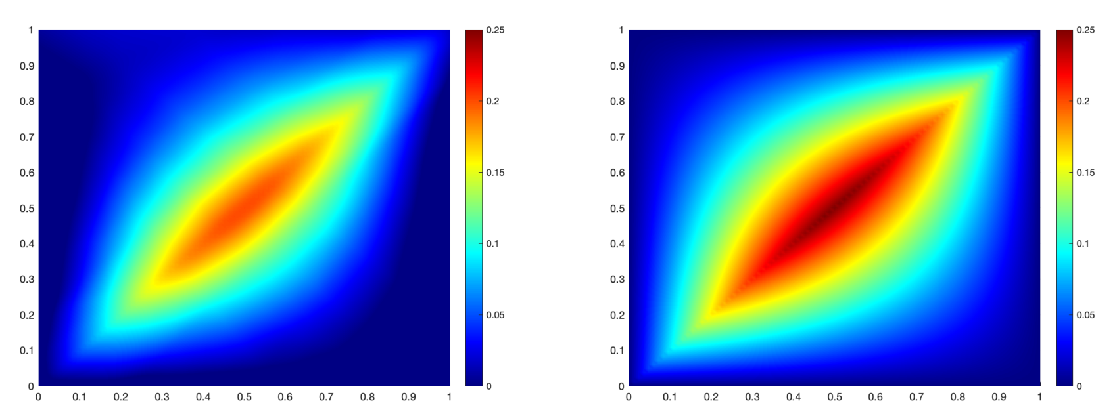
Neural Operator architecture
Neural Operator
$$ψ_{θ}=Q∘σ\left(K_{T−1}+{W_{T−1}+b}_{T−1}\right)∘…∘σ\left(K_{0}+{W_{0}+b}_{0}\right)$$
Verification – 1D Poisson’s equation
$G(x,x^{′})=\frac{1}{2}(x+x^{′}−\left|x−x^{′}\right|−xx′)$
Learned Kernal function
Analytical solution
Uniform Converge!

Slide 16
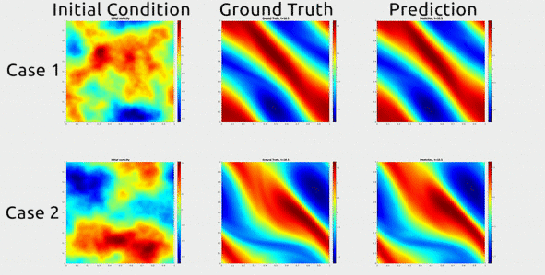
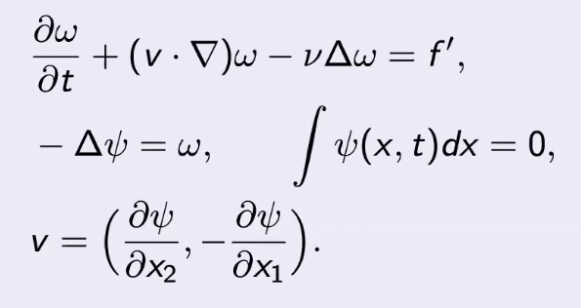
Neural Operator architecture
Neural Operator
$$ψ_{θ}=Q∘σ\left(K_{T−1}+{W_{T−1}+b}_{T−1}\right)∘…∘σ\left(K_{0}+{W_{0}+b}_{0}\right)$$
2D Navier Stokes
Example – Nonlinear PDE

Slide 17
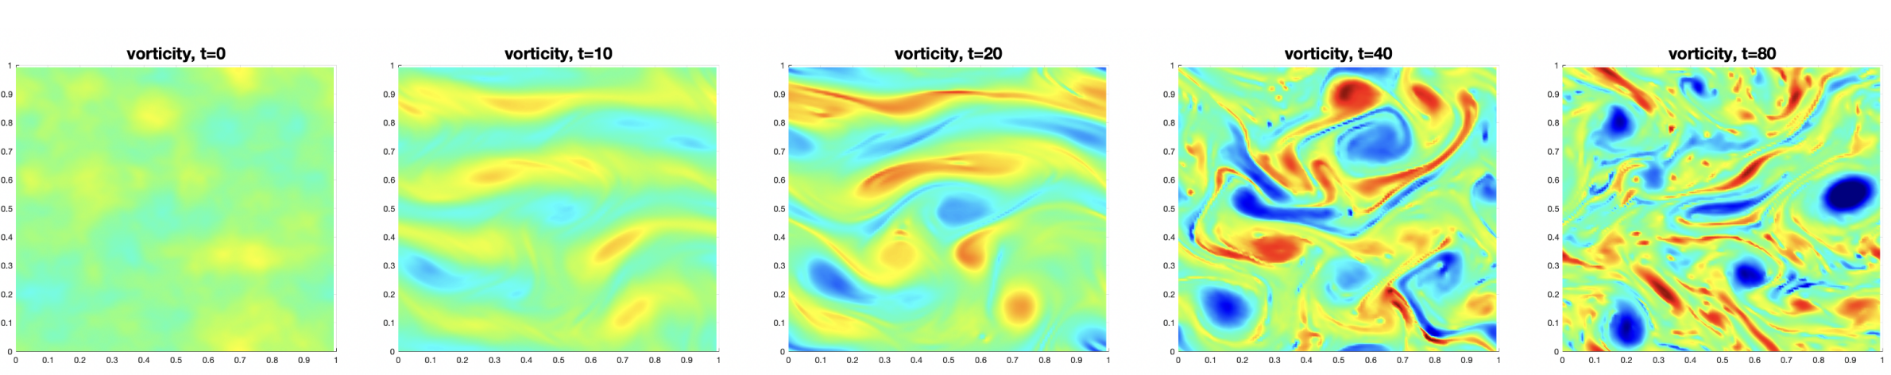
Neural Operator architecture
Neural Operator
$$ψ_{θ}=Q∘σ\left(K_{T−1}+{W_{T−1}+b}_{T−1}\right)∘…∘σ\left(K_{0}+{W_{0}+b}_{0}\right)$$
Example – Chaotic system
Solution is Chaotic
Li, Zongyi, et al. "Learning chaotic dynamics in dissipative systems." Advances in Neural Information Processing Systems 35 (2022): 16768-16781.

Slide 18
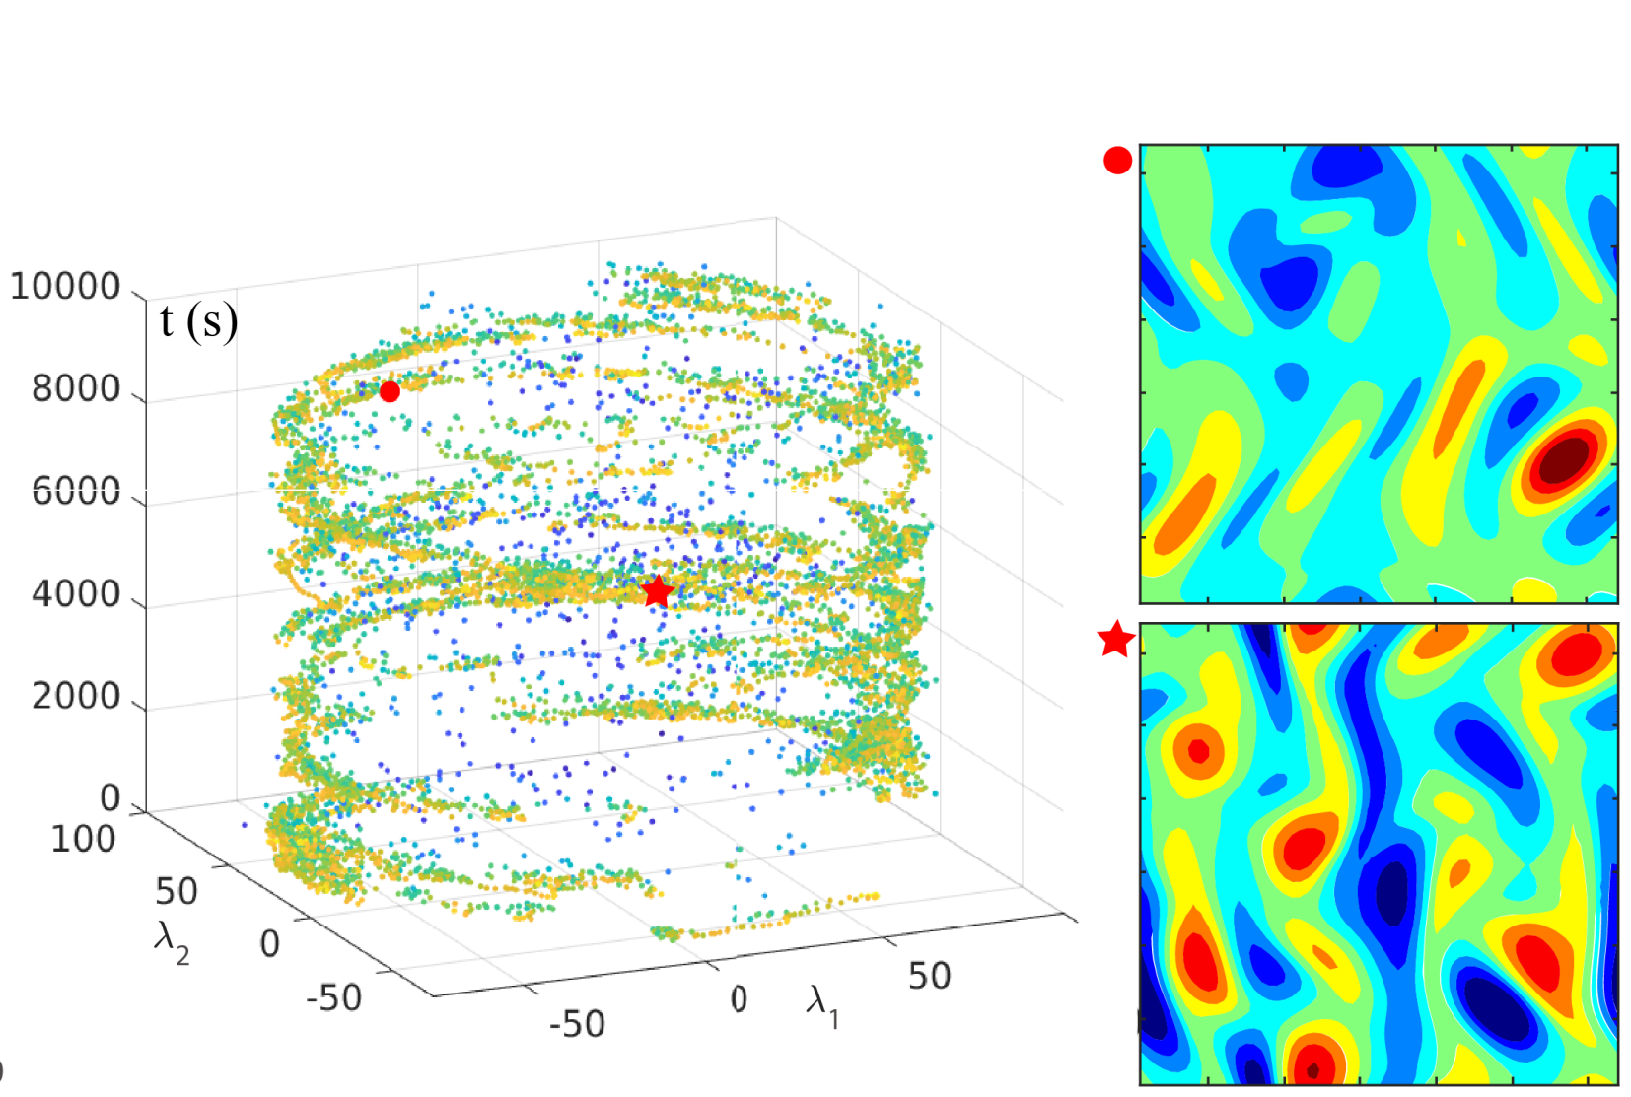
Neural Operator architecture
Neural Operator
$$ψ_{θ}=Q∘σ\left(K_{T−1}+{W_{T−1}+b}_{T−1}\right)∘…∘σ\left(K_{0}+{W_{0}+b}_{0}\right)$$
But we can learn the attractor

Slide 19
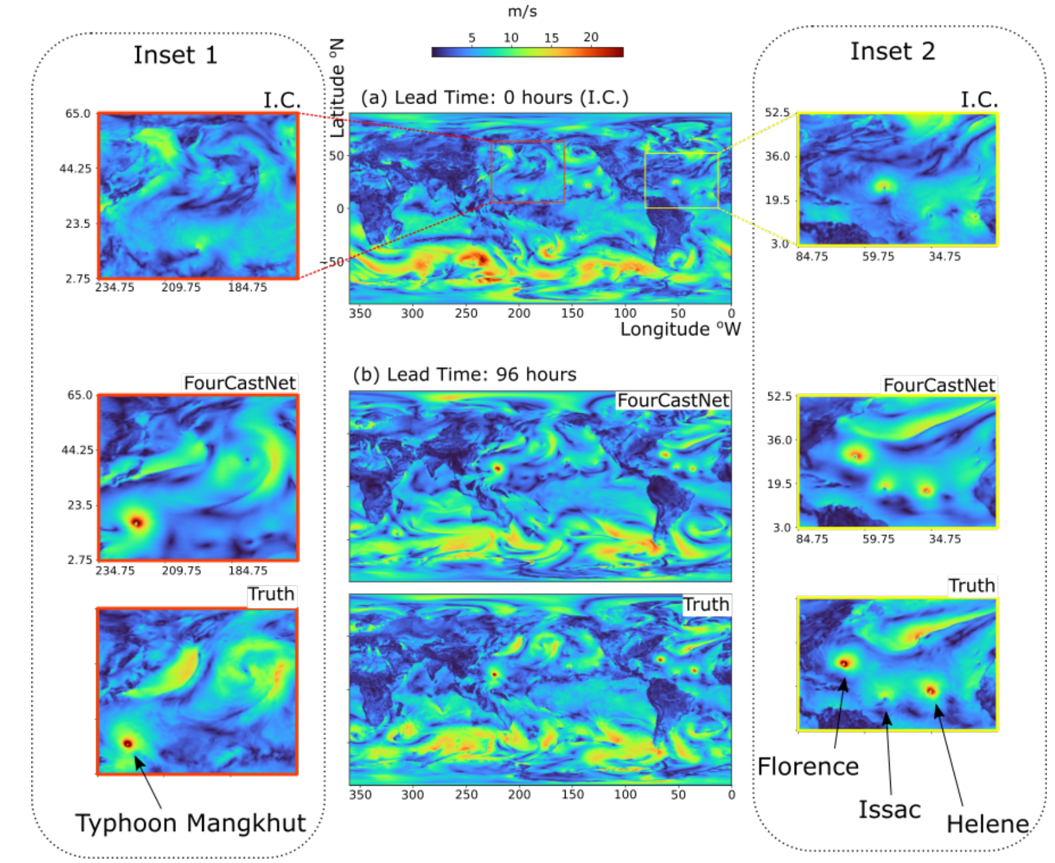
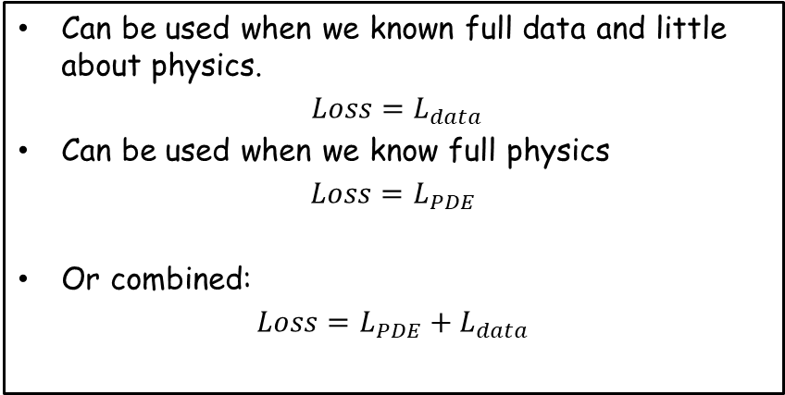
Fourcast Net - NVDIA
Neural Operator is an architecture
Can be used when we known full data and little about physics.
$Loss=L_{data}$
Can be used when we know full physics
$$Loss=L_{PDE}$$
Or combined:
$$Loss=L_{PDE}+L_{data}$$
Pathak, Jaideep, et al. "Fourcastnet: A global data-driven high-resolution weather model using adaptive fourier neural operators." arXiv preprint arXiv:2202.11214 (2022).

Slide 20
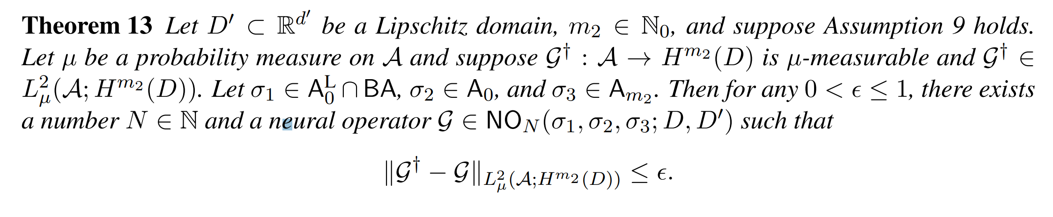
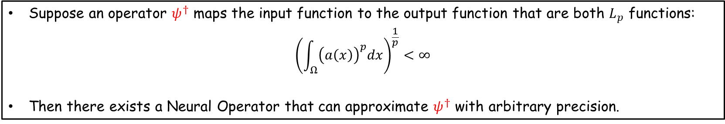
Neural Operators are Universal Operator Approximators
In summary
Suppose an operator $ψ^{†}$ maps the input function to the output function that are both $L_{p}$ functions:
$${\left(\int_{Ω}{{\left(a\left(x\right)\right)}^{p}dx}\right)}^{\frac{1}{p}}<∞$$
Then there exists a Neural Operator that can approximate $ψ^{†}$ with arbitrary precision.
Kovachki, Nikola, et al. "Neural operator: Learning maps between function spaces with applications to PDEs." Journal of Machine Learning Research 24.89 (2023): 1-97.

Slide 21
Summary
Neural Operator – a generalization of Neural Networks
Key idea: replace the convolution matrix in Neural Networks by integral transform with a kernel function!
Next lecture
Learning with irregular data – Graph Neural networks and Graph Neural Operator:
Learning PDE with smooth fields – Fourier Neural Operator

